Slide 1
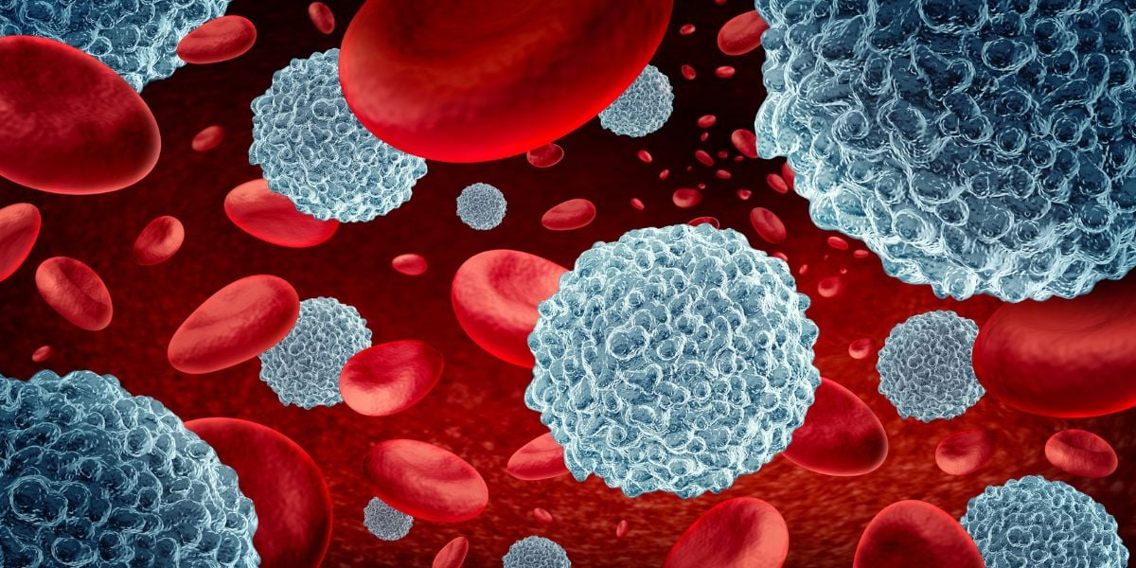


Machine Learning
Group Work – Assignment 2
Blood Cell AI –
Classification of Blood cell subtypes
Hendrik Künnemann - 57995
Luc Marcel Pellinger - 58611
Moritz Lind - 61230
Tomás Shoemaker Simão Gonçalves - 47016
Zeno Eule - 59093

Slide 2

Transforming Blood-Based Disease Diagnostics with AI
BloodCell AI wants to revolutionize blood-based disease diagnostics through artificial intelligence
Our Purpose and Mission:
We are dedicated to saving lives by revolutionizing blood-based disease diagnostics by leveraging artificial intelligence. We strive to surpass CellVision Diagnostics in building the best model for blood-based disease diagnostics, ensuring our technology leads the way in reliable, efficient, and life-saving diagnostics.
The 4 Pillars of Our Work
Precise Classification
Clinical Significance
Efficiency and Reliability
Seamless Integration
Blood Cell AI identifies and classifies blood cell subtypes such as Eosinophils, Lymphocytes, Monocytes, and Neutrophils
Utilizes cutting-edge AI technology that is trained on a comprehensive dataset of high-resolution blood cell images
Essential for diagnosing conditions such as asthma (identified by elevated Eosinophil counts) and detecting infections or immune responses (noted by variations in Lymphocyte and Monocyte levels)
Cutting diagnostic time from hours to minutes is a vital step that saves precious time, ultimately contributing to saving lives
Minimizes human error, ensuring rapid and informed treatment decisions
AI models seamlessly integrate into existing healthcare systems
Makes state-of-the-art diagnostics accessible worldwide, ensuring precise and reliable blood sample analysis for a wide range of people
BloodCell AI empowers healthcare professionals to deliver superior patient care based on timely and accurate blood sample analysis. We invite you to join in transforming healthcare diagnostics with AI-driven insights!

Slide 3
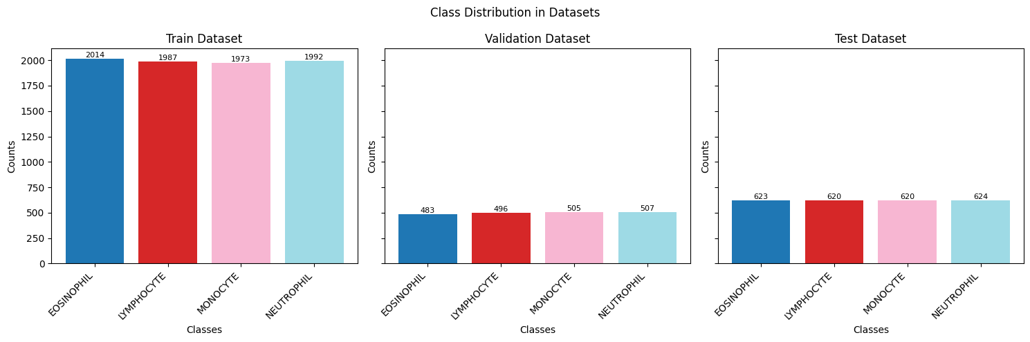
Data at the Heart: Exploring the Blood Cell AI Dataset
Our AI models are trained on a meticulously curated dataset of high-resolution blood cell images
Dataset Acquisition:
Dataset Composition:
Data Handling Protocol:
Training and Validation:
In collaboration with renowned research hospitals, BloodCell AI acquired a diverse dataset, including augmented pictures.
This dataset underwent rigorous curation processes to ensure data quality and relevance to our diagnostic goals.
The dataset comprises a comprehensive collection of blood cell subtypes, including Eosinophils, Lymphocytes, Monocytes, and Neutrophils.
These subtypes are crucial indicators for various diseases and medical conditions.
To maintain the robustness of our AI models, we implemented a stringent data handling protocol.
The dataset is meticulously divided into distinct training, validation, and test directories.
Data is further split into training and validation subsets.
The training subset enables comprehensive model learning, while the validation subset facilitates parameter optimization without compromising generalization.
Conclusion
The quality and composition of our dataset are integral to BloodCell AI's mission of transforming healthcare diagnostics.
By leveraging this diverse and meticulously curated dataset, we ensure that each analysis is precise, dependable, and contributes to superior patient care.

Slide 4
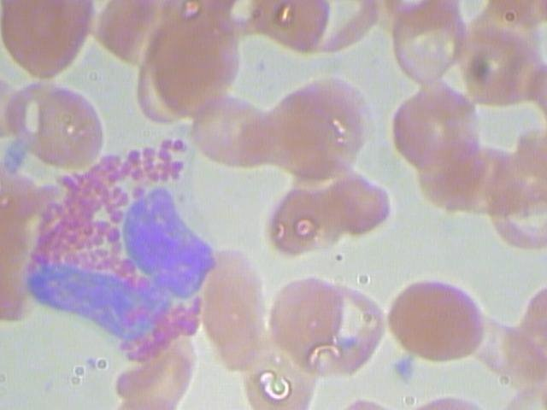
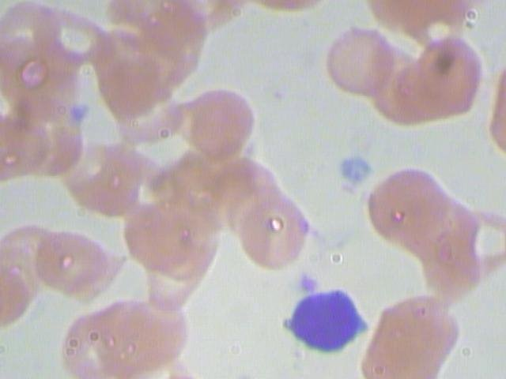
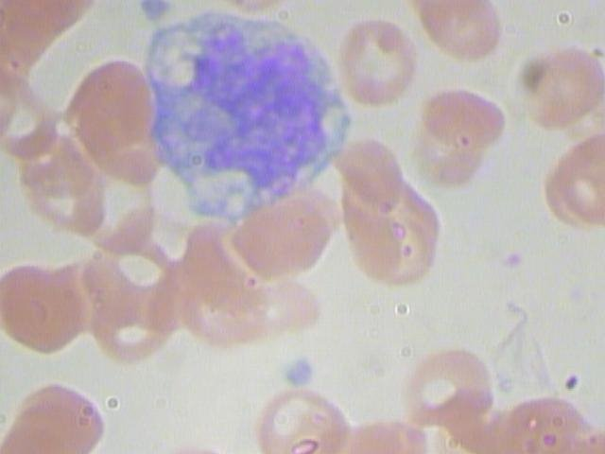
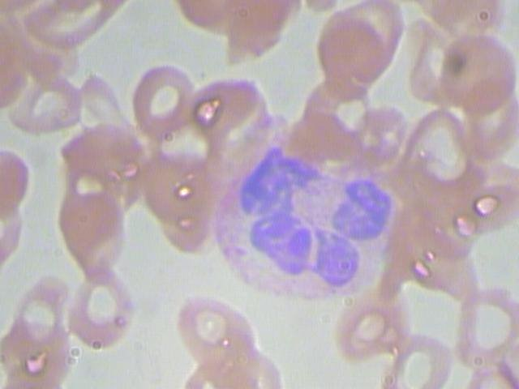
Data at the Heart: Understanding Benefits of Recognizing & Classifying
Early detection leads to timely diagnosis and treatment, treatment monitoring tracks effectiveness, patient management improves care based on cell changes, and risk assessment evaluates infection and complication risks.
Eosinophils
Lymphocytes
Monocytes
Neutrophils
Allergic Reactions: Indicates asthma, eczema, hay fever.
Parasitic Infections: Points to parasitic infections.
Autoimmune Disorders: Signals conditions like eosinophilic esophagitis.
Viral Infections: Sign of viral infections (e.g., mono, hepatitis).
Chronic Inflammatory Conditions: Indicates diseases like rheumatoid arthritis.
Immune Response: Assesses immune system status, especially in HIV/AIDS.
Chronic Infections: Indicates chronic infections (e.g., tuberculosis).
Inflammatory Conditions: Associated with inflammatory diseases.
Cancer Detection: Linked to leukemia and lymphoma.
Bacterial Infections: Suggests bacterial infections (e.g., pneumonia).
Acute Inflammation: Marker for acute inflammation (e.g., heart attack).
Neutropenia: Low counts indicate bone marrow issues or chemotherapy effects.

Slide 5

Modeling – Road Map
Path to Optimal Blood Cell Classification: From Baseline to Advanced Models
Baseline
Benchmark
Transfer Learning
Transformer
Baseline
Simple CNN
Model Exploration
& Selection
Final Training
Bayesian Optimization
Benchmark
Competitor's Complex CNN
Bayesian Optimization
Model Exploration & Selection
Final Training

Slide 6
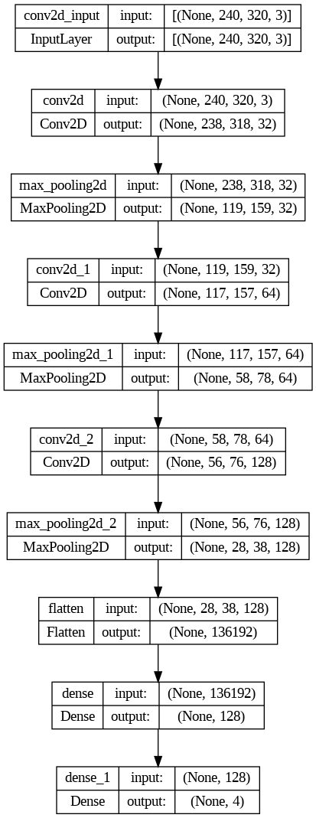
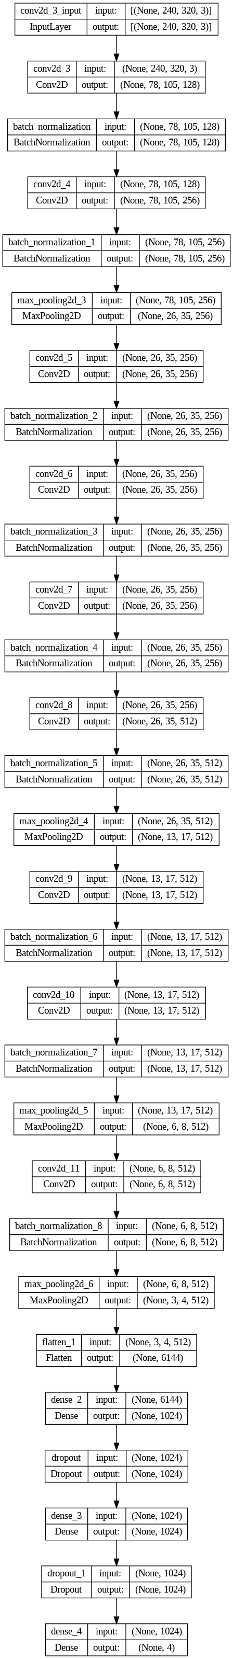


Modeling – Baseline & Benchmarking
Establishing the Foundation: Baseline and Benchmark Models
Basline
Benchmark
CellVision Diagnostics
Feature Extraction with 3 CNN Layers
Preparational Flatten layer
Dense layer with 128 units.
Final layer for classification.
Test Accuracy: 24.41%
Feature Extract with multiple CNN Layers
Max pooling layers to reduce dimensions.
Preparational flatten layer.
2 Dense Layers with dropout
Final layer for classification.
Test Accuracy: 60.35%

Slide 7
Modeling – Transfer Learning
Leveraging Pre-Trained Models: Exploring Transfer Learning
Model Exploration
& Selection
Bayesian Optimization
Final Training
Dropout rate
Batch normalization
L2 regularization
Grid
Baseline CNN
Benchmark CNN
More Epochs
Early Stopping
Data Augmentation
Random Horizontal Flipping
Random Rotation
Random Contrast
Random Brightness
Random Translation
Monitoring validation loss
with patience = 3
100 Epochs instead of only 10
[0.5, None]
[True, False]
[0.01, None]
VGG16
VGG19
MobileNet V2
Inception V3
Xception
ResNet50
ResNet101
NASNet Mobile
DenseNet 121
EfficientNetB0

Slide 8
Modeling – Transformer
Further Boosting our Model’s Performance with a State-of-the-Art Transformer
Model Exploration
& Selection
Bayesian Optimization
Final Training
Learning rate
# Neurons in dense layer
Dropout Rate
Batch Normalization
L2 regularization
Grid
[1e-5, 1e-2]
[128, 256]
[0.5, None]
[True, False]
[1e-5, 1e-2]
More Epochs
Early Stopping
Data Augmentation
Random Horizontal Flipping
Random Rotation
Random Contrast
Random Brightness
Random Translation
Monitoring validation loss
with patience = 3
100 Epochs instead of only 10
Vision Transformer
Data-efficient Image Transformer
Swin Transformer

Slide 9
Modeling – Transformer
Boosting our Model’s Accuracy by 16 p.p. (27%) with Transformer XiT – and the Baseline Model’s Accuracy by 51 p.p. (204%)
Model Exploration
& Selection
Bayesian Optimization
Final Training
Learning rate
# of Attention Heads
Hidden Layer Size
Drop Out Rate
Batch Normalization
Feedforward
# of Transformer Layer
Grid
[1 e-5, 1 e-3]
[8, 12]
[256, 512]
[0.1, 0.3]
[True, False]
[1024, 20248]
[4, 6]
More Epochs
Early Stopping
Data Augmentation
Random Horizontal Flipping
Random Rotation
Random Contrast
Random Brightness
Random Translation
Monitoring validation loss
with patience = 3
100 Epochs instead of only 10
Vision Transformer
Data-efficient Image Transformer
Swin Transformer

Slide 10
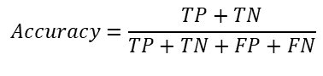
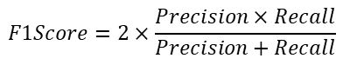

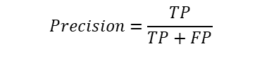
Performance
Metrics for Evaluation
Metric
Accuracy
Precision
Recall
F1-Score
Definition
Proportion of true results (both true positives and true negatives) among the total number of cases examined.
Proportion of true positives among the total positive predictions.
Proportion of true positives among the total actual positives.
Harmonic mean of precision and recall.
$$Accuracy=\frac{TP+TN}{TP+TN+FP+FN}$$
$$Precision=\frac{TP}{TP+FP}$$
$$Recall=\frac{TP}{TP+FN}$$
$$F1Score=2×\frac{Precision×Recall}{Precision+Recall}$$
Importance
General Measure of model performance
Insufficient in case of class imbalance due to skewed results
Risk of disease cells being misclassified
Critical for minimizing false positives, which is especially important for medical diagnostics to prevent inappropriate treatments.
Ensures that as many actual positive cases as possible are detected, essential for not missing critical diagnostic information.
Balanced measurement of the overall model’s performance in handling both false positives and false negatives.
Approach
Rather than evaluating each model immediately after its implementation, we plan to systematically log their performance metrics during training using TensorBoard. This allows us to efficiently compile and review all relevant performance data at the end of our modeling phase.
In summary, while accuracy gives a general idea of model performance, it does not provide detailed insights into our model's behavior concerning false positives and false negatives. Precision and recall are more informative metrics in medical diagnostics, ensuring that the model is both specific and sensitive to the presence of diseases.

Slide 11
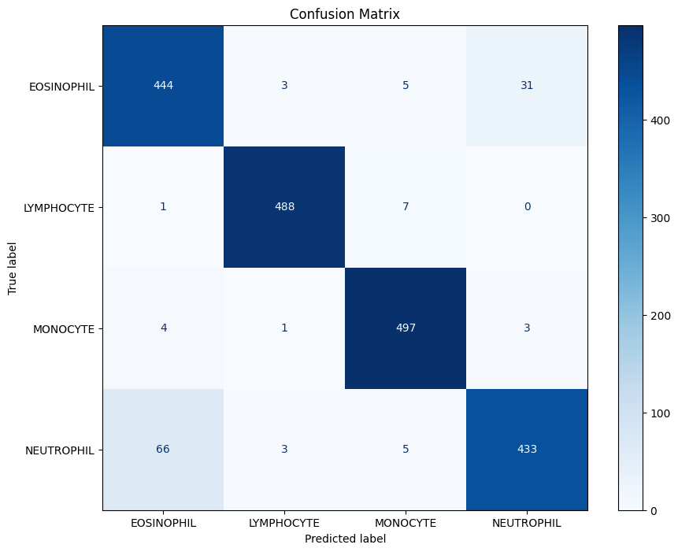
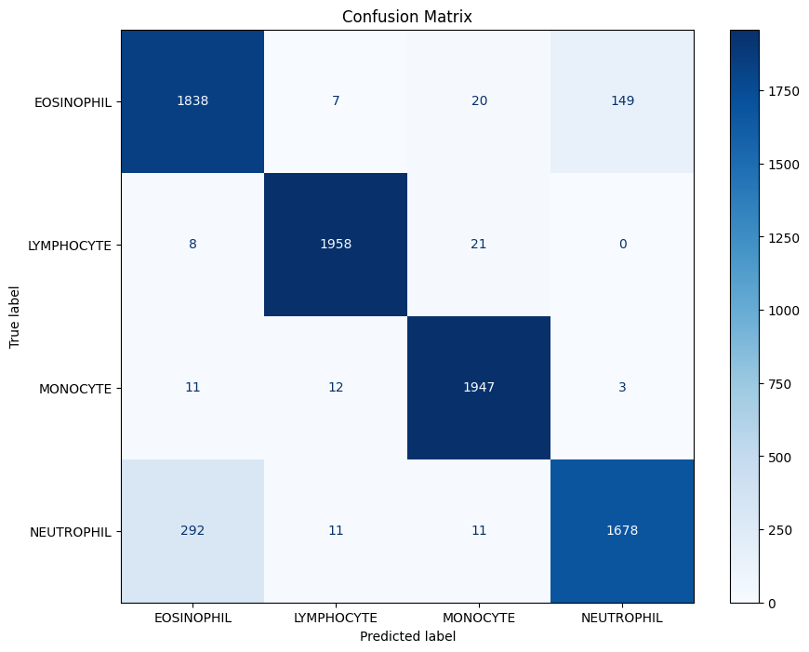
Results - Training
Performance of the best model
Accuracy = 0.94 | Precision | Recall | F1-Score
Eosinophil | 0.86 | 0.92 | 0.89
Lymphocyte | 0.99 | 0.98 | 0.98
Monocyte | 0.97 | 0.98 | 0.98
Neutrophil | 0.93 | 0.85 | 0.89
Accuracy = 0.93 | Precision | Recall | F1-Score
Eosinophil | 0.86 | 0.91 | 0.88
Lymphocyte | 0.98 | 0.99 | 0.99
Monocyte | 0.97 | 0.99 | 0.98
Neutrophil | 0.92 | 0.84 | 0.88

Slide 12
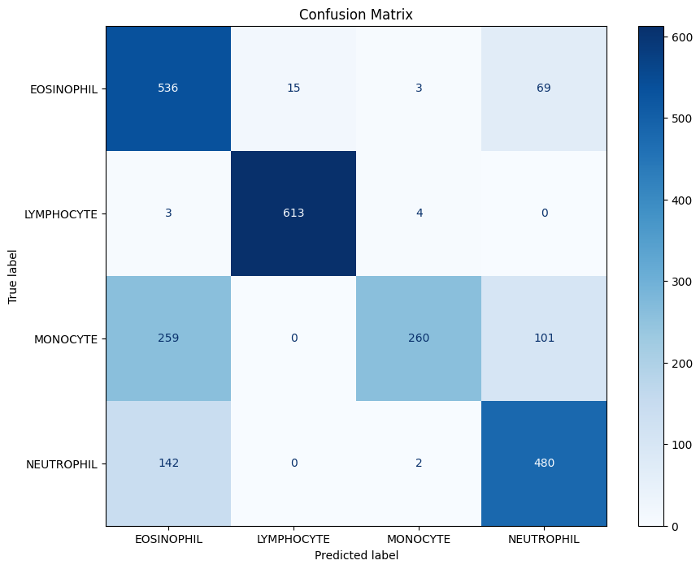
Results - Validation
Performance of the best model
Accuracy = 0.76 | Precision | Recall | F1-Score
Eosinophil | 0.57 | 0.86 | 0.69
Lymphocyte | 0.98 | 0.99 | 0.98
Monocyte | 0.97 | 0.42 | 0.58
Neutrophil | 0.74 | 0.77 | 0.75
Accuracy = 0.94 | Precision | Recall | F1-Score
Eosinophil | 0.86 | 0.92 | 0.89
Lymphocyte | 0.99 | 0.98 | 0.98
Monocyte | 0.97 | 0.98 | 0.98
Neutrophil | 0.93 | 0.85 | 0.89
Accuracy = 0.93 | Precision | Recall | F1-Score
Eosinophil | 0.86 | 0.91 | 0.88
Lymphocyte | 0.98 | 0.99 | 0.99
Monocyte | 0.97 | 0.99 | 0.98
Neutrophil | 0.92 | 0.84 | 0.88

Slide 13

Results - Test
Performance of the best model
Accuracy = 0.76 | Precision | Recall | F1-Score
Eosinophil | 0.57 | 0.86 | 0.69
Lymphocyte | 0.98 | 0.99 | 0.98
Monocyte | 0.97 | 0.42 | 0.58
Neutrophil | 0.74 | 0.77 | 0.75
Accuracy = 0.94 | Precision | Recall | F1-Score
Eosinophil | 0.86 | 0.92 | 0.89
Lymphocyte | 0.99 | 0.98 | 0.98
Monocyte | 0.97 | 0.98 | 0.98
Neutrophil | 0.93 | 0.85 | 0.89

Slide 14



Conclusion
Outperforming CellVision Diagnostics
Performance
BloodCell AI outperforms competitors, offering superior results in cell classification and disease diagnosis.
Metrics
The superiority in all metrics ensures quicker and better diagnostics, enhancing medical decision-making and saving valuable time for healthcare professionals.
 | CellVision | BloodCell
Accuracy | 0.60 | 0.76
Precision | 0.65 | 0.81
Recall | 0.65 | 0.76
F1-Score | 0.65 | 0.78
Quality of Patient Care
Adoption of BloodCell AI by medical facilities enhances the quality of patient care while optimizing resources, resulting in improved financials and operational efficiency.
Strategic Investment
Incorporating BloodCell AI into medical practice represents a strategic investment in both patient outcomes and organizational effectiveness.

Slide 15

Modeling
Model Selection (1/2 – Baseline and Benchmark)
Convolutional Layers: Three layers with filters increasing from 32 to 128, all using 3×33×3 kernels and ReLU activation. Each convolutional layer is followed by a 2×22×2 max pooling layer to reduce spatial dimensions.
Flatten Layer: Converts the 3D output to a 1D vector for the dense layers.
Dense Layers: One dense layer with 128 units and ReLU activation, followed by an output layer with softmax activation designed for multi-class classification based on the number of classes (num_classes).
Convolutional Layers: Multiple layers with increasing filter sizes from 128 up to 512, using 3×33×3 to 8×88×8 kernels, ReLU activation, and same padding. Each layer is followed by batch normalization.
Pooling Layers: Max pooling applied after specific convolution layers to reduce spatial dimensions.
Flatten Layer: Converts the multi-dimensional output of the last convolutional layers into a flat vector.
Dense Layers: Two dense layers, each with 1024 units and ReLU activation, separated by 50% dropout layers to prevent overfitting.
Output Layer: Softmax layer with 4 outputs for multi-class classification.
Baseline Model
Benchmark Model (Kaggle)

Slide 16
Modeling
Model Selection (2/2 – Transfer Learning)
Both models are known for their simplicity and depth, with layers stacked directly on top of each other. They are excellent for capturing complex patterns in image data, making them suitable for detailed features in blood cell images.
Utilizing residual connections to enable training of very deep networks by allowing gradients to flow through the network without vanishing. These models are beneficial for our project as they can learn from a significant amount of residual features without the risk of performance degradation with increased depth.
Features densely connected convolutional networks where each layer connects to every other layer in a feed-forward fashion. This connectivity pattern promotes feature reuse, making it highly efficient and accurate, especially for varied medical imaging data.
Utilizes Neural Architecture Search to optimize its topology. This results in a highly optimized structure that excels in handling complex tasks like classifying different types of blood cells, where precision is crucial.
VGG16 & VGG19
InceptionV3 & Xception
ResNet50 & ResNet101
MobileNetV2
DenseNet121
EfficientNet121
NASNetMobile
These models introduce modules with parallel convolutions, optimizing performance by handling different aspects of the input data simultaneously. Their architecture allows for efficient feature extraction at multiple scales, which is advantageous for images with varying sizes and shapes of cells.
This model is designed for mobile and edge devices but maintains high accuracy. Its lightweight architecture uses depthwise separable convolutions to reduce the model size and complexity, making it faster without sacrificing performance.
Known for scaling up CNNs in a more structured manner using a compound coefficient to manage depth, width, and resolution of the networks. This model provides a balanced architecture that can handle complex image classifications with fewer parameters.

Slide 17
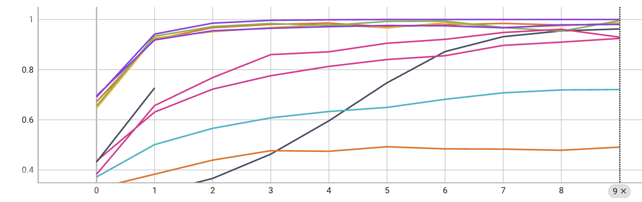
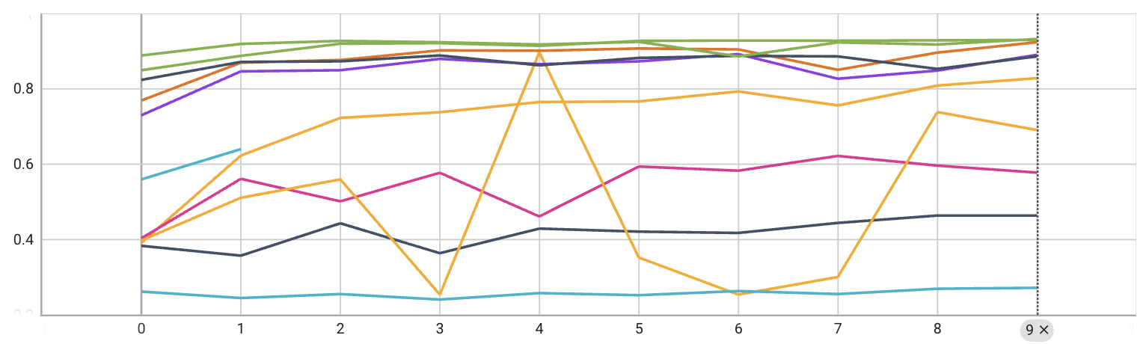
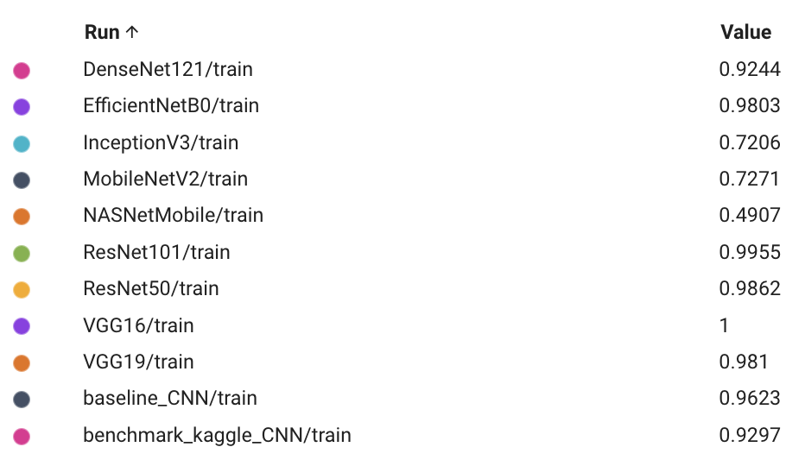
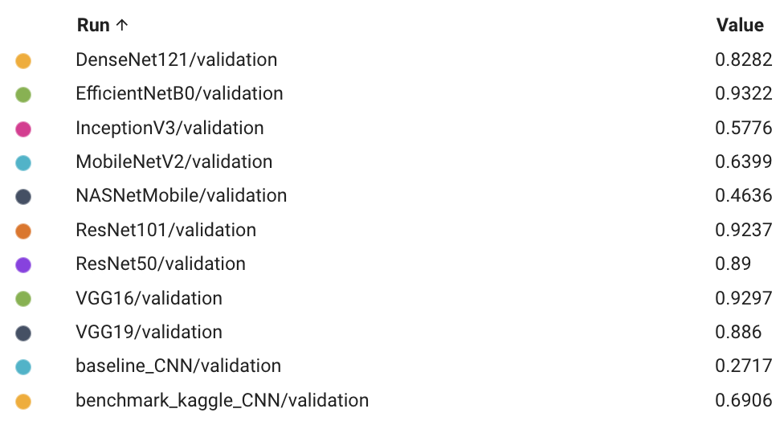



Modeling
Model Selection (2/2 – Transfer Learning)

Slide 18
Modeling
Fine Tuning the Best Model
Model Selection
Hyperparameter Optimization
Final Training
Learning rate
# Neurons in dense layer
Dropout rate
Batch normalization
L2 regularization
( # Dense Layers )
Baseline CNN
Benchmark CNN
Grid
More Epochs
Early Stopping
Data Augmentation
Random Horizontal Flipping
Random Rotation
Random Contrast
Random Brightness
Random Translation
Monitoring validation loss
with patience = 3
100 Epochs instead of only 10
[0.01, 0.001]
VGG16
VGG19
MobileNet V2
[128, 256]
Inception V3
Xception
[0.5, None]
ResNet50
ResNet101
NASNet Mobile
[True, False]
[0.01, None]
DenseNet 121
EfficientNetB0
[1, 2]

